Slide 1



PREDICTING STOCK PRICES USING MACHINE LEARNING MODELS
Amr Elhag Aly Y00866881
amelhagaly@student.ysu.edu

Slide 2

INTRODUCTION
This project focuses on integrating sentiment analysis and stock price data to predict stock price movements.
Real-time news data is fetched from Alpha Vantage API (replacing Yahoo News and Twitter), and sentiment scores are extracted.
The model uses AWS SageMaker Autopilot to train and predict based on the combined data.

Slide 3

BACKGROUND
Stock Market Prediction: Predicting stock price movements is a challenging problem due to the volatility and complexity of stock prices influenced by external news, market conditions, and investor sentiment.
Sentiment Analysis: Analyzing sentiment from news or social media allows for the prediction of market movements based on public perception, investor sentiment, and economic events.
AWS Services:
AWS Lambda for serverless data processing.
SageMaker Autopilot for machine learning automation.

Slide 4


Services Used
SageMaker Autopilot automates model selection, training, and hyperparameter tuning, integrating with S3 for easy deployment and real-time predictions.
Amazon S3 stores raw and processed data, ensuring scalable and secure data management.
AWS Lambda automates tasks like fetching data, triggering model training, and sending notifications, enabling a serverless, event-driven architecture.

Slide 5
PROBLEM STATEMENT
The goal is to build an automated system that can predict stock price movements based on sentiment analysis of financial news.
Challenges faced:
Real-time data fetching and processing.
Handling unstructured text data (news) and transforming it into useful features.
Building a reliable and scalable machine learning pipeline.

Slide 6

Phase 01
Data Sources Integration:
Alpha Vantage API fetches financial news articles.
Lambda functions trigger periodic fetching of data.
Data Preprocessing & Consolidation
The stock price data is consolidated with the news data based on the publication date of the news articles and the closest stock price available on or before that date.
Phase 02
Phase 03
Machine Learning with SageMaker Autopilot:
The sentiment scores are combined with stock price data to predict stock movements.
SageMaker Autopilot automatically selects and tunes the best model.
METHODOLOGY

Slide 7
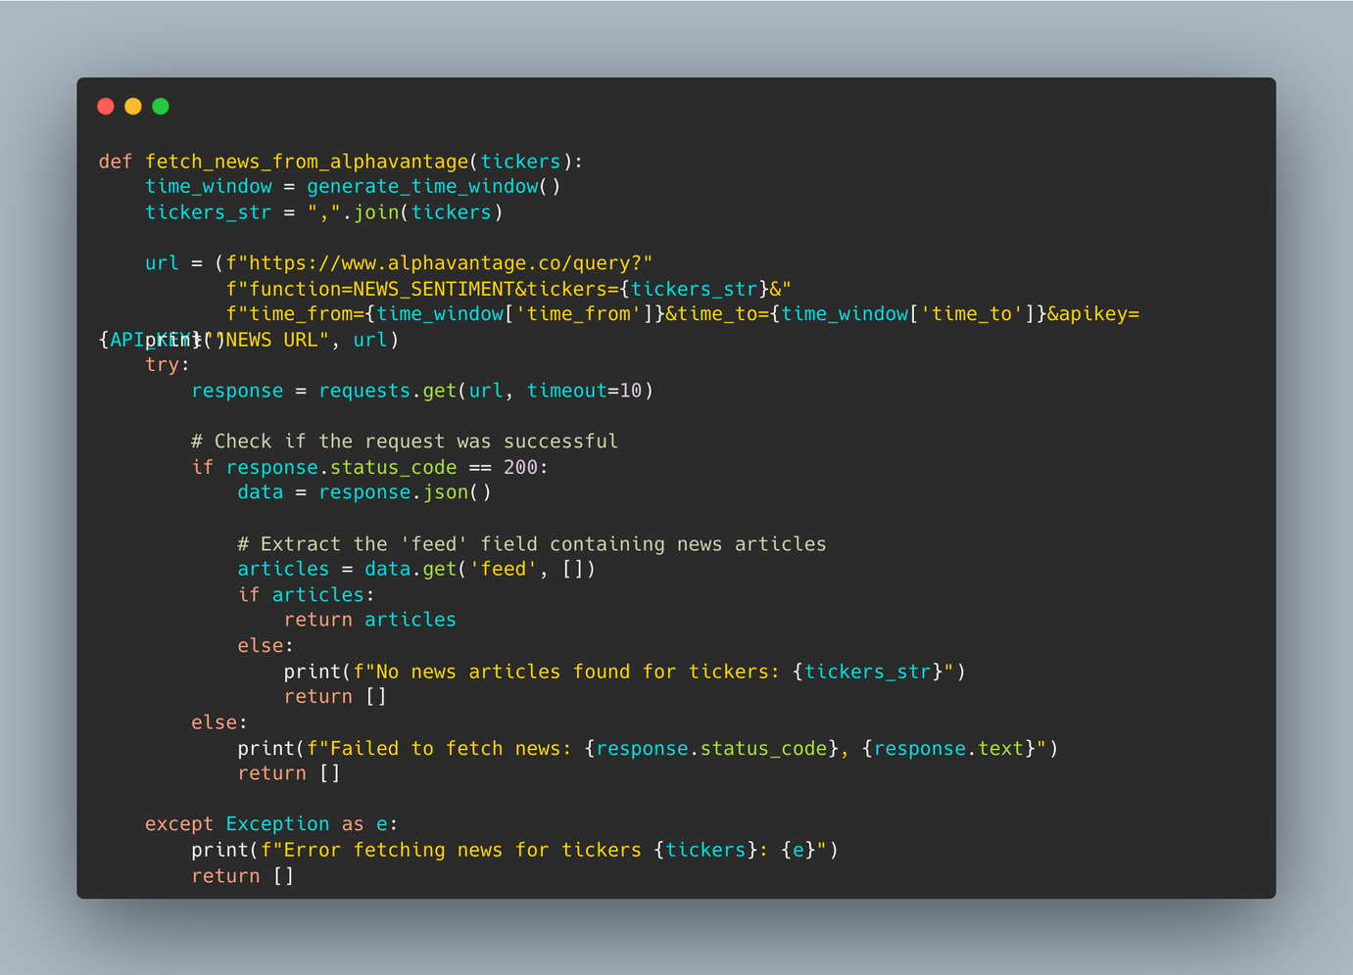

CORE SERVICES
fetches sentiment-labeled news articles for specified tickers from Alpha Vantage within a dynamically generated time window.

Slide 8
STOCK PRICE FETCHING WITH TECHNICAL ANALYSIS
Key Features & Technical Analysis Advantages:
Technical Indicator Calculation:
Computes essential technical indicators like SMA (Simple Moving Average), EMA (Exponential Moving Average), RSI (Relative Strength Index), MACD (Moving Average Convergence Divergence), and Bollinger Bands.
SMA & EMA Indicators:
These indicators help identify trends, smooth out price fluctuations, and generate buy/sell signals based on moving average crossovers.
RSI Analysis:
Provides insights into overbought or oversold conditions, aiding in predicting potential price reversals.
MACD & Signal Line:
Used to identify momentum shifts and trend reversals by analyzing the relationship between short- and long-term price movements.
Bollinger Bands:
Offers a dynamic range for price movements, helping to gauge volatility and potential price breakouts or breakdowns.
Data Integration Ready:
Combines raw price data with technical indicators for easy merging with news sentiment data, enabling more informed predictions and analysis.

Slide 9
Data Sample
DATE: 2024-11-29
TITLE: AMAZON RISES 10.4% SINCE Q3 EARNINGS: TIME TO BUY THE STOCK?
SUMMARY:
"AMZN'S SOARING PROFITS, AWS DOMINANCE, AND AI LEADERSHIP MAKE IT A COMPELLING BUY DESPITE PREMIUM VALUATION, AS GROWTH MOMENTUM SIGNALS STRONG UPSIDE POTENTIAL."
SENTIMENT: BULLISH (SCORE: 0.498544)
SOURCE: ZACKS COMMENTARY
TOPICS: RETAIL & WHOLESALE, FINANCIAL MARKETS, EARNINGS, TECHNOLOGY
RELATED TICKER SENTIMENT:
AMZN: BULLISH (SCORE: 0.507017)
STOCK PRICE (AMZN):
OPEN: 205.83
CLOSE: 207.89
VOLUME: 24,892,400
SMA-20: 204.50
RSI: 58.68
BOLLINGER HIGH: 214.51
BOLLINGER LOW: 194.50

Slide 10
DISCUSSION
Challenges Faced:
Inconsistent news sources and their impact on sentiment scores.
Stock price prediction accuracy may vary with market volatility and external events.
Limitations:
News sentiment analysis alone might not capture all market factors affecting stock prices.
Real-time predictions depend on continuous data flow and system stability.

Slide 11
CONCLUSION
The system successfully integrates news sentiment and stock price data to predict stock prices.
AWS SageMaker Autopilot enables automated model training and prediction.
Future improvements could involve integrating more data sources and refining models with additional features like economic indicators or social media sentiment.

